Slide 1

Minor project (First Review)
Presented by: Ricky Vashi
Guided by : Prof. Jitendra Bhatia Sir

Slide 2
agenda
✅ Introduction to Centralized Record Management ✅ Challenges & Issues in Centralized Systems ✅ Proposed Solution: A More Secure Approach ✅ Introduction to Decentralized Tamper-Proof Records ✅ Advantages of Decentralization ✅ Key Technologies Explored ✅ Understanding Blockchain & Its Importance ✅ Role of Solidity & Smart Contracts ✅ MetaMask Integration with Smart Contracts

Slide 3
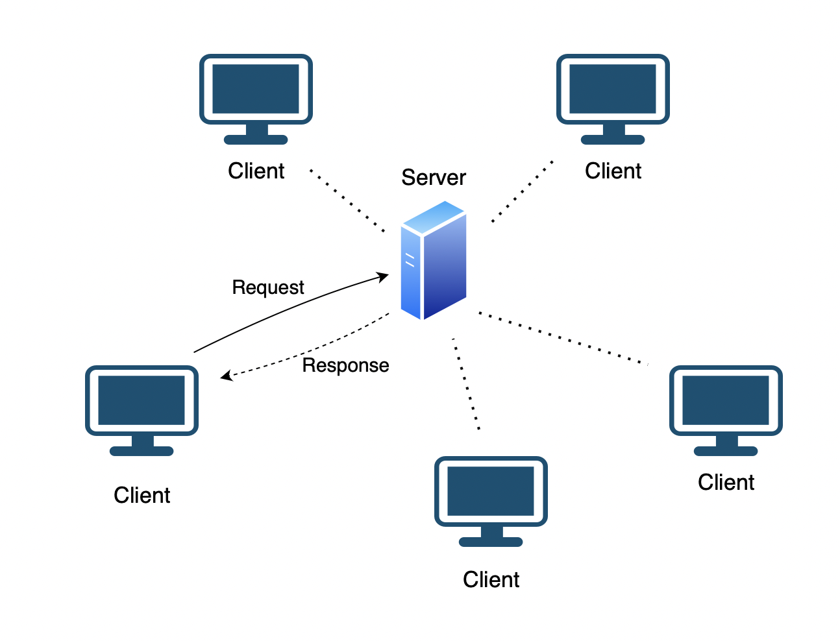
Centralized Record Management
Centralized record management relies on a single authority or database for storing and maintaining records.
Common in government, healthcare, banking, and enterprise data management.
Example: Traditional databases like MySQL, Oracle, or centralized cloud storage.

Slide 4
Issues in Centralized Systems
Single Point of Failure: If the central server fails, all data is at risk.
Data Tampering: Administrators or hackers can alter or delete records.
Lack of Transparency: Users must trust a third party for data integrity.
Security Risks: Prone to cyberattacks, unauthorized access, and data breaches.

Slide 5
How to Prevent These Issues?
Decentralization: Storing records across multiple nodes prevents single-point failure.
Tamper-Proof System: Ensuring records cannot be altered after they are stored.
Transparency: Public verification of data ensures trust.
Security: Use of cryptographic techniques to safeguard data integrity.

Slide 6
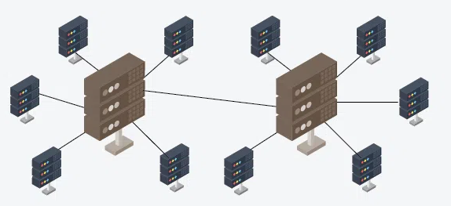
Introducing MY Solution
Decentralized Tamper-Proof Record Management
Legal Sector: Secure storage of court records and legal documents.
Healthcare: Tamper-proof medical records and patient history.
Supply Chain Management: Transparent tracking of goods and transactions.
Education: Secure storage of academic certificates and transcripts.
Driver’s Past Record: Secure storage and verification of driver history and violations.

Slide 7

Advantages of Decentralization
Immutability: Once stored, records cannot be altered.
Security: Cryptographic encryption protects data.
Transparency: Publicly verifiable records enhance trust.
No Single Point of Failure: Data remains safe even if some nodes fail.

Slide 8

How We Implement Decentralized System
What is Blockchain?
A distributed ledger that records transactions securely.
Why Blockchain for Record Management?
Ensures data integrity
Removes intermediaries
Provides verifiable records

Slide 9
Supporting Technologies for Blockchain Implementation
Vue.js & Node.js – Frontend and Backend Development
Solidity – Smart Contract Development
Ethereum/Hyperledger – Blockchain Platform
MongoDB/IPFS – Data Storage Options
MetaMask – Wallet for Ethereum Transactions
Remix IDE – Smart Contract Deployment & Testing
Web3.js & Ethers.js – Interacting with the blockchain

Slide 10
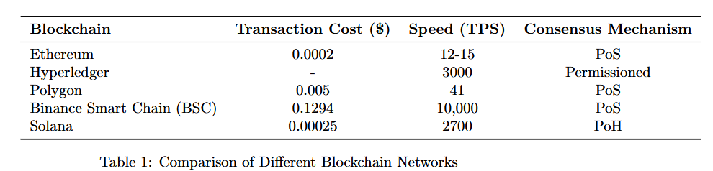
Blockchain Comparison & Suitability

Slide 11
Conclusion & Next Steps
Summary:
I explored the limitations of centralized systems.
I introduced a decentralized solution using blockchain.
I learned & discussed key technologies enabling this project.
Next Steps:
Implement & test the system.
Prepare a working demo for the next review.

Slide 12
REFERNCES
https://etherscan.io/
https://ycharts.com/indicators/ethereum_average_transaction_fee
https://hyperledger-fabric.readthedocs.io/en/release-2.5/
https://docs.polygon.technology/pos/
https://www.bnbchain.org/en
https://solana.com/news/tag/blockchain

Slide 13
Thank you

